Slide 1

MIGHTY CAT MASKED NIYANDER (AN EPISODIC ADVENTURE)

Slide 2
INTRODUCTION
This story is about a cat named niyander who protects
His hometown from the clutches of a king named skeleton
King.
Niyander’s sister gets kidnapped and the present story
Revolves around finding her.
But the plot turns into an other direction as the game moves on and niyander has to save the day.

Slide 3

ABOUT THE GAME
THE GAME CONSISTS OF 5 LEVELS AND ALL ARE DIFFERENT
CHALLENGES FACED BY NIYANDER AND THE STORY ALSO RUNS
PARALLEL TO IT.

Slide 4
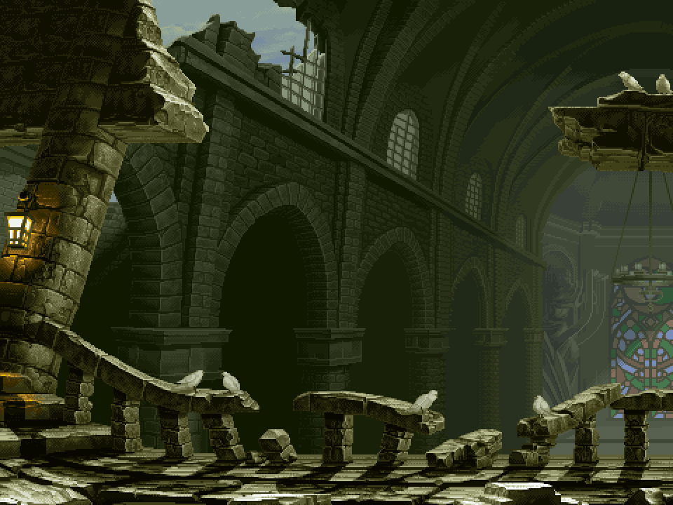
LEVEL 1- THE CASTLE OF SHADOWS
This level is played using the arrow keys and the basic aim of this levels to dodge the incoming fire balls from a monster and survive for 100 seconds by jumping on the magical mats provided .You are given a health bar of 100 for this particular level.

Slide 5
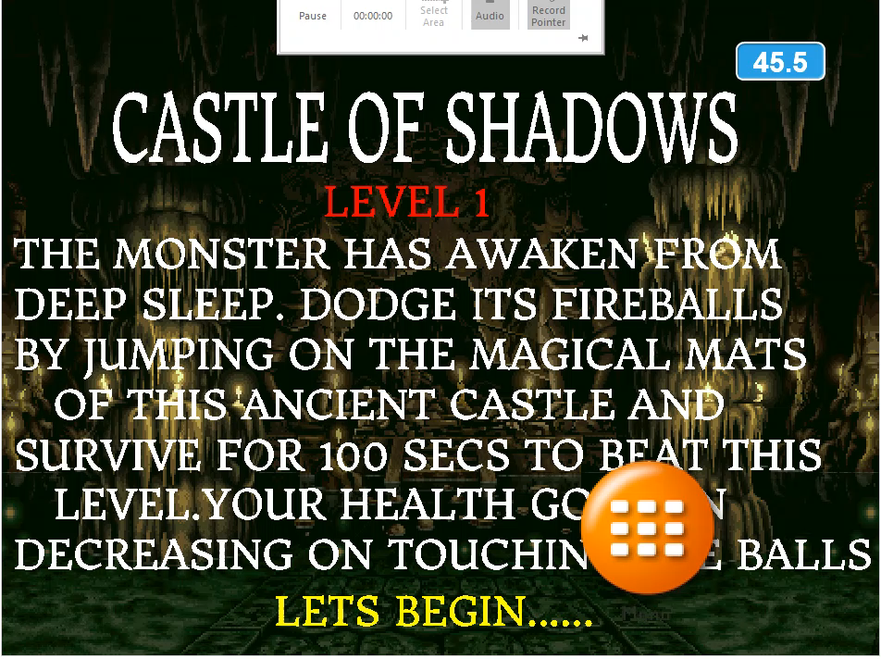
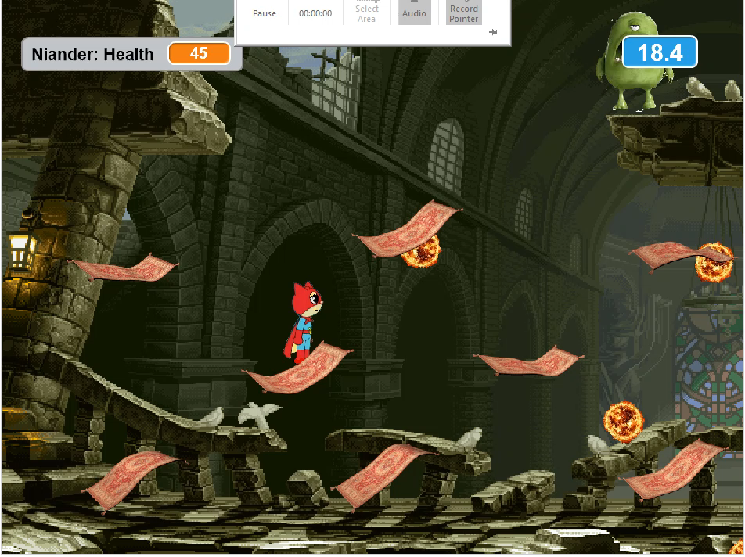

Slide 6

Level 2 – the black forest blast
This level is played with the arrow key controls .
The objective of the level is to dodge the incoming cannon balls and reach the other end within 100 secs without falling into lava pits at the bottom of the screen.
Your health decreases on touching the
Cannonballs.

Slide 7
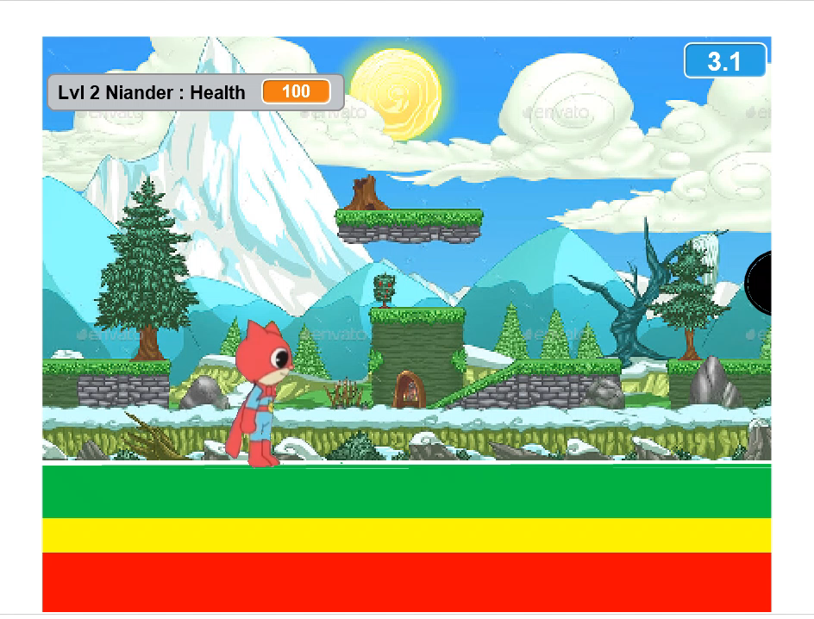

Slide 8

Level 3 – sky is the limit !!
1)This level has been made with one of The most interesting features of Scratch version 2.0 and is exciting to Play.
2)This level includes video sensing which eliminates the use of mouse and keyboard and gives a 3d effect to the player .
3)This level includes controlling the sorites with your fingers and the aim is to survive hawks attack for 105 seconds. Your health decreases on touching hawks.

Slide 9


Slide 10

Level 4 – THE CRISIS CAVERNS
This level is a very interesting maze level where a manuscript (sprite) is randomly changing its position every time you collect it and the player has to find it and collect it exactly 6 times before the time runs out (100 secs).
The level has something more to it as well that makes It more challenging that is the maze is hidden and only the part near the sprite is visible

Slide 11
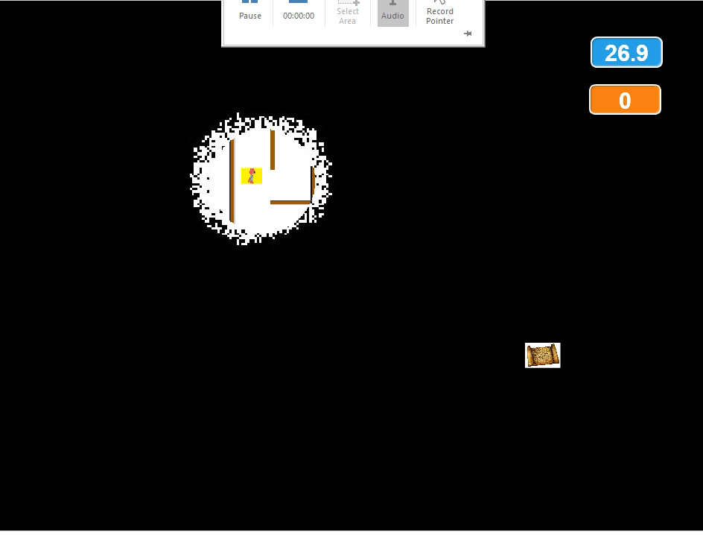

Slide 12
Level 5 –THE FINAL SHOWDOWN
This is the last level of the game and this level is also played using touch sensing mode .
This level is a survival mode level where the enemy is constantly firing deadly spike balls towards us and we need to survive for 100 seconds.
This level marks the end of the game and the story as well

Slide 13
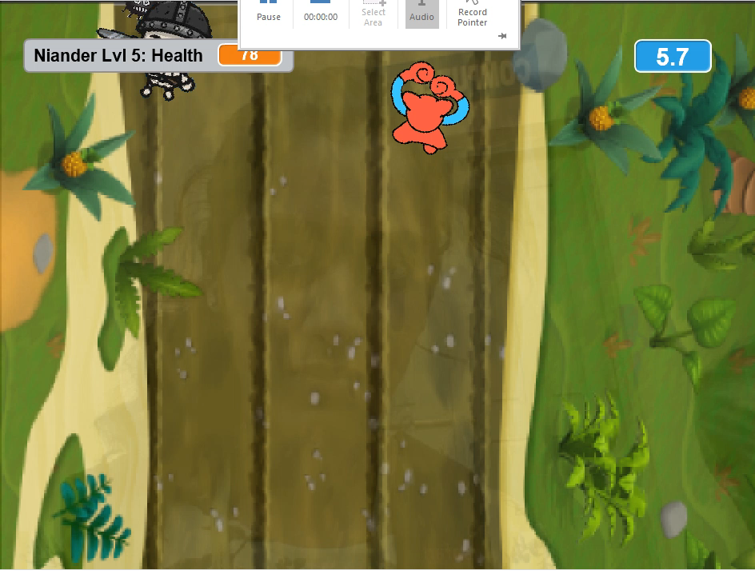

Slide 14
game statistics and overview
The game has a total 0f 47 backdrops and 80 + sprites in it.
The game has 2 specially made video sensing levels.
The game contains more than 30 audio recordings with 10+ background music’s .
The game also includes a story running parallel to the GAME and the levels are a continuation part of the story.

Slide 15
FLEXIBILITY
THE GAME IS DIVIDED INTO 5 STORY PARTS AND 5 LEVELS WHICH ARE PLAYED ALTERNATIVELY TO MAKE A WHOLE .
WE HAVE ADDED A MENU BAR AS A NEW FEATURE TO PROVIDE FLEXIBILITY FOR THE PLAYER TO SELECT HIS/HER CHOICE OF LEVEL OR TO VIEW A PARTICULAR STORY PART.

Slide 16
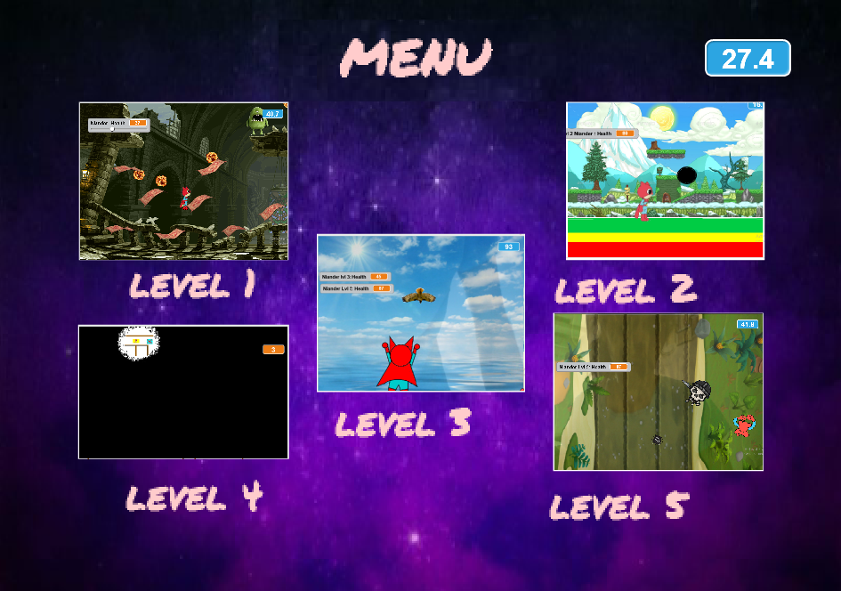

Slide 17
basic algorithm
Start
menu
story
instructions
STORY LVL 1
game
INSTRUCTIONS LVL 1
win
NO
YES
WON SPRITE
LOST SPRITE
NEXT LVL
end

Slide 18

WE HOPE YOU HAVE A GREAT EXPERIENCE !!
THANK YOU
BY- PRIYAL JAIN
ABHISHEK.Y

